Slide 1

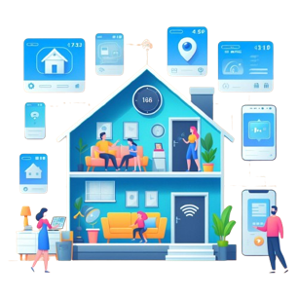
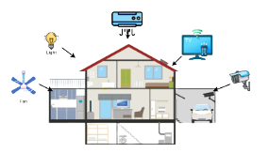


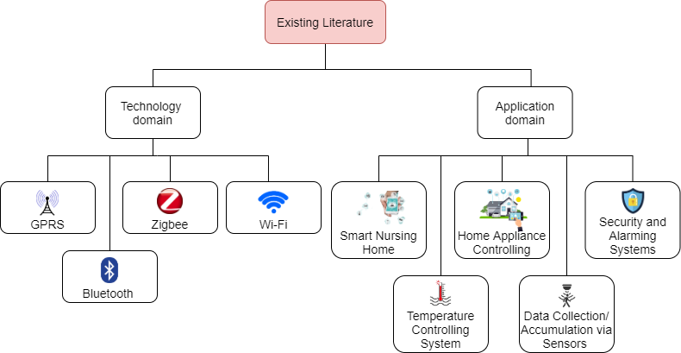
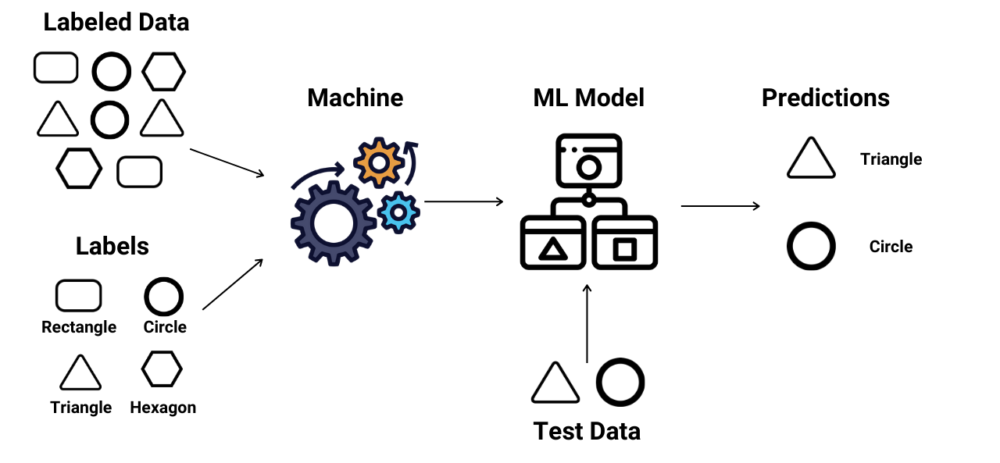
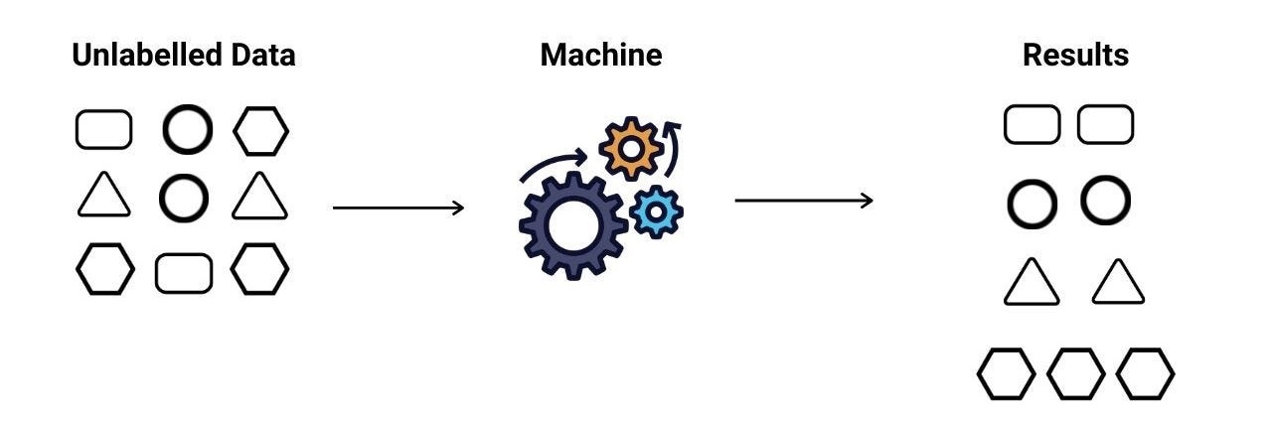
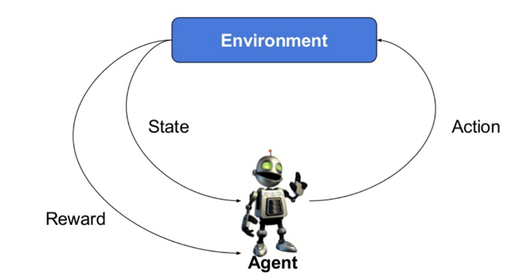
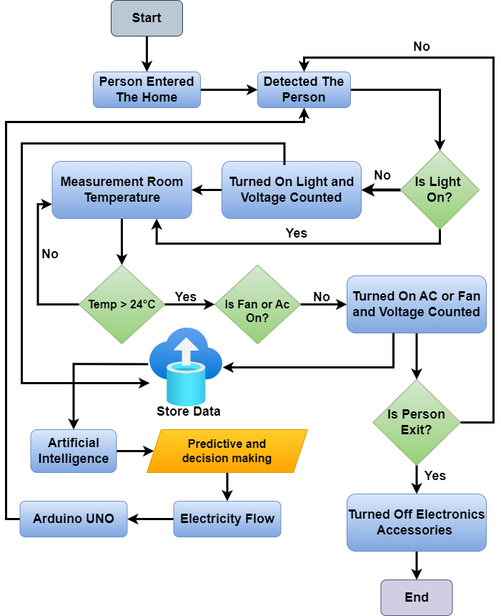
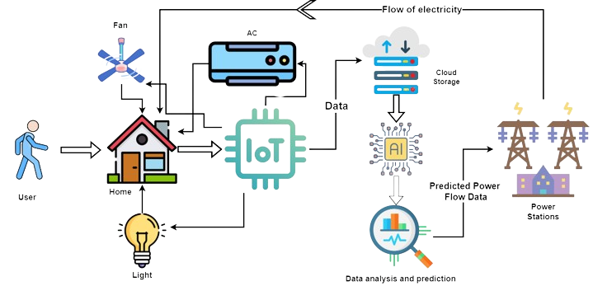
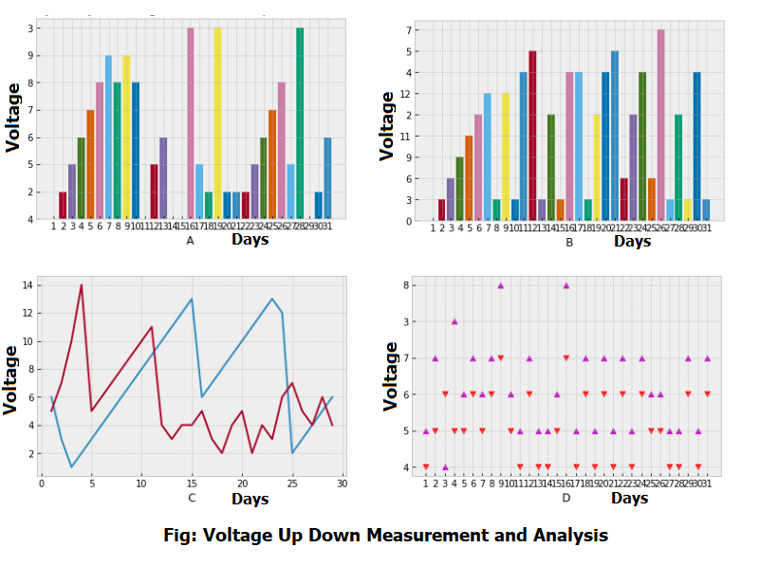
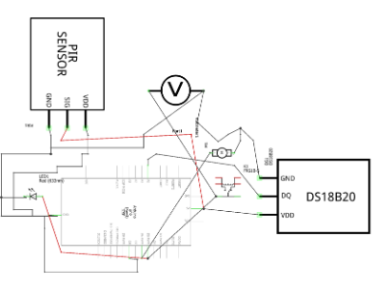
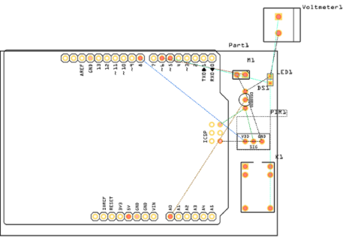
Smart Sage: IoT-Driven Home Automation Framework with Predictive Machine Learning
Rayhan Al Shorif and Khondaker Abdullah Al Mamun
Overview
Introduction
The home self-regulation concept is growing in popularity for reducing human effort including errors and thus increasing efficiency. We can manage remote home appliances help of Home self-regulation. Across our nation, communities grapple with power shortages stemming from inaccuracies in electricity metering. Whether in bustling industrial zones, densely populated urban centers, or residential neighborhoods, the need for reliable energy access is paramount. By establishing annual electricity quotas tailored to these specific regions, we have the opportunity to preempt numerous power disruptions plaguing our society. Our pioneering efforts in this endeavor are epitomized by the successful implementation of a groundbreaking pilot project.
The concept of home self-regulation is rapidly gaining traction as a means to streamline household management, minimize human error, and enhance overall efficiency. With the aid of remote home appliance management, individuals can effortlessly oversee and control various devices from afar, optimizing energy usage and comfort levels with unparalleled convenience.
Prediction With Machine Learning
Existing Work
00
Data Flow Diagram of the Proposed System
Methodology of This System
Result and Analysis
Our proposed framework offers invaluable assistance in automating the trac-
king and control of the smart home environment. Leveraging a reinforcement
learning algorithm, our system efficiently processes information to manage
home equipment, enabling informed decisions for optimal functionality.
Implementing this method yields successful identification of home appliance
usage and monitoring data with precision.
Schematic and PCB of Proposed system
Conclusion
Reference
Our project focuses on using sensors to make smart homes more efficient by reducing power usage. We aim to optimize energy consumption by managing devices effectively. Our system will recognize individuals, provide personalized interactions, and sync household devices automatically to streamline home management.
[1]. Mahmud, S., Ahmed, S. and Shikder, K., 2019, January. A smart home automation and metering system using internet of things (IoT). In 2019 International Conference on Robotics, Electrical and Signal Processing Techniques (ICREST) (pp. 451-454). IEEE.
[2]. Jabbar, W.A., Kian, T.K., Ramli, R.M., Zubir, S.N., Zamrizaman, N.S., Balfaqih, M., Shepelev, V. and Alharbi, S., 2019. Design and fabrication of smart home with Internet of Things enabled automation system. IEEE Access, 7, pp.144059-144074

